Slide 1
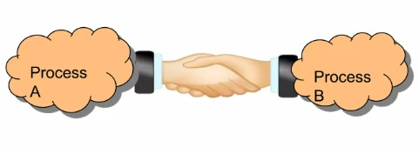
PIPES AND NAMED PIPES
Presented by:
M.B.R.Pranav
ID:MISSES0423

Slide 2
What to Expect?
What is Inter Process Communication?
Various IPC mechanism in Linux
Pipes
Limitations of pipe
Named pipes –(FIFO’s)
Limitations of Named pipe.
Difference between pipe and Named pipe?
Pipes and Named pipes examples.
Reference

Slide 3
What is IPC ?
Processes within a system may be independent or cooperating
Mechanism whereby one process can communicate or exchange data,with another process
Set of techniques for the exchange of data among multiple threads in one or more process.
Processes may be running on one or more computers connected by a network.
Client/Server computing always uses IPC.
Network programming can be easy.

Slide 4
IPC Mechanisms:
It is used for exchanging data between multiple threads in one or more processes or programs. The Processes may be running on single or multiple computers connected by a network. The full form of IPC is Inter-process communication.
Message passing:
→Sending message to others processes or receive message from them.
Share a memory:
→Area with other processes.
Synchronize:
→Itself with other processes by means of ‘Semaphores.

Slide 5
Why IPC ?
Information Sharing
Resource sharing
Computation speedup
Synchronization
Modularity
Convenience

Slide 6
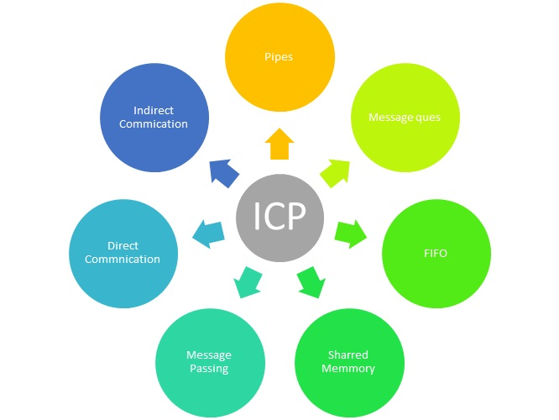
Approaches for Inter-Process Communication
Message Queues
IPC

Slide 7

What is pipe ?
Pipe is a communication medium between two or more related or interrelated processes. It can be either within one process or a communication between the child and the parent processes.
Pipe mechanism can be viewed with a real-time scenario such as filling water with the pipe into some container, say a bucket, and someone retrieving it, say with a mug. The filling process is nothing but writing into the pipe and the reading process is nothing but retrieving from the pipe. This implies that one output (water) is input for the other (bucket).

Slide 8
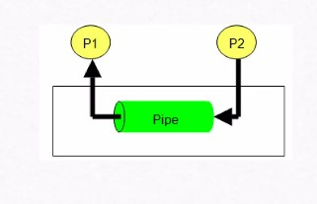
->Pipes are the oldest form of IPC mechanism, they are half duplex dataflow in one direction.
->Pipes is nothing but kernel buffer which is created in kernel space of ram where parent and child can communicate.
->The size of kernel buffer is 16kb.which is depends upon kernel version.in that kernel buffer the pipe uses the 4096 bytes(4kb).
->The shell will create a separate process for each command and links the standard output of one process to the standard input of next by using pipe.
->Pipe is created by using pipe();(system call).

Slide 9
Pipe();
Header file: #include<unistd.h>
Return type: int
Function name: pipe
Declaration:
int pipe (int fd[2]);
→On success it will return ‘0’.
→On failure it returns ‘ -1’.
→When this call is successful it will create the file objects. These file objects entries are updated in file descriptor table and entries are updated in input arguments.

Slide 10
→The fd [0] are updated with 1 index value.And fd [1] are updated with another index value.(the values are nothing but file descriptors).
The fd 0 are open for reading.
The fdf 1 are open for writing.
Note: using pipe system call we can send parent to child or child to parent by using single pipe
→Read(); system call on this file descriptors behaves as a blocking signal until parent or child writes the data into buffer()pipe .
→Improper handling of pipes system call will generate SIGPIPE signal to terminate the process.
→This is a half-duplex method, so the first process communicates with the second process. However, in order to achieve a full-duplex, another pipe is needed.

Slide 11
Limitations :
As a channel of communication a pipe operates in one direction only.
Pipes cannot support broadcast i.e. sending message to multiple processes at the same time.
The read end of a pipe reads any way. It does not matter which process is connected to the write end of the pipe. Therefore, this is very insecure mode of communication.
This are uni-directional and half duplex.

Slide 12
Example program 2 − Program to write and read two messages through the pipe using the parent and the child processes.
Algorithm
Step 1 − Create a pipe.
Step 2 − Create a child process.
Step 3 − Parent process writes to the pipe.
Step 4 − Child process retrieves the message from the pipe and writes it to the standard output.
Step 5 − Repeat step 3 and step 4 once again.

Slide 13
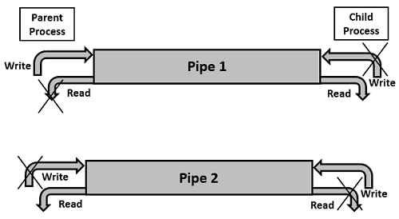
When we have two pipes to develop as server client communication?

Slide 14
Named pipes
Named pipes are also known as FIFO’S
These IPC can be used in between unrelated process(Different process)
A Named pipe can have multiple process communicating through it like multiple clients connected to one server.
A FIFO special file is entered into the file system by calling mkfifo() system call.
A FIFO file is a special kind of file on the local storage which allows two or more processes to communicate with each other by reading/writing to/from this file.

Slide 15
mkfifo()
Header file : #include<sys/stat.h>
Return type : int
Function name : mkfifo()
Declaration:
int mkfifo(const char *path,mode_t mode);
First input : FIFO special file with name pathname.
Second input : mode specifies the FIFO’s permissions.
On success it will return 0
On failure it will return -1

Slide 16
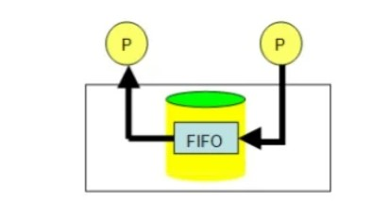
It will creates a fifo object in a current working directory .
Each process will have it’s own fifo’s object in working directory.
Same file permissions (or) modes are applicable for fifo object but it is not a normal textual file it is a special file.
Open() and read() behaves has the blocking call on fifo objects.
Open() behaves has the blocking until other process open the same fifo object.
Read() comes out of blocking state until the other process writes the data on the same fifo object.

Slide 17


Server
Client
mkfifo()
Open() →Acts as the blocking call.
Read()
Open() → It unblocks the client blocking state
Write()
Open() →It unblocks the server blocking state
Write()
mkfifo()
Open() → Acts as blocking call
Read()

Slide 18
Difference between Pipes and Named pipes
Pipes
1.It is used between related process.
2.Pipe is created as a kernel buffer in kernel space.
3.Two entries are updated in file descriptor table.
4.In pipes read() behaves as a blocking call.
5.When process terminates the pipe corresponding objects and buffers are destroyed.
Named pipes
1.It is used between unrelated process .
2.A special file is created as a fifo object in current working directory.
3.Only one entry get’s updated in file descriptor table.
4.In Named pipes both read() and open() behaves as a blocking call.
5.When the process terminates this fifo objects still exist in your current working directory.

Slide 19
Rules:
Server has to start first and we should have any one server which can communicate with multiple clients.
Server has to wait (or) blocks until the client send the request.
After receiving the request server process and sends the request back.
For two communication both server and client their own fifo’s they must open it.

Slide 20
#include<stdio.h>
#include<string.h>
#include<fcntl.h>
#include<unistd.h>
#include<stdlib.h>
#include<stdio_ext.h>
#include<sys/stat.h>
Int main()
{
pid_t pid;
int fd[2];
char buf[100];
int ret;
ret=pipe(fd);
if(ret < 0)
{
printf(“Failed to create pipe\n”);
exit(1);
}
pid=fork();
if(pid < 0)
{
printf(“Failed to create child process\n”);
exit(1);
}
Pipes example

Slide 21
else if( pid > 0)
{
close(fd[0]);
ret=write(fd[1],”Hello”,strlen(“Hello”));
if(ret < 0)
{
printf(“Failed to write\n”);
exit(1);
}
close(fd[1]);
exit(0);
}
else
{
close(fd[1]);
ret=readfd[0],buf,100);
if(ret < 0)
{
printf(“Failed to read\n”);
exit(1);
}
write(1,buf,ret);
close(fd[0]);
exit(0);}
}

Slide 22
#include<stdio.h>
#include<string.h>
#include<fcntl.h>
#include<unistd.h>
#include<stdlib.h>
#include<stdio_ext.h>
#include<sys/stat.h>
int main()
{ char wstr[30];
char rstr[30];
int ret,fd,ret1;
while(1)
{
fd=open("server_fifo",O_RDONLY);
if(fd < 0)
{
ret=mkfifo("server_fifo",0660);
if(ret < 0)
{
printf("Failed to create the fifo file\n");
exit(1);
}
fd=open("server_fifo",O_RDONLY);
if(fd < 0)
{
printf("Failed to open the special file(fifo)\n");
exit(1);
}
}
Server side code

Slide 23
printf("Client message\n");
ret=read(fd,rstr,29);
if(ret < 0)
{
printf("failed to perform the read operation\n");
exit(1);
}
ret1=write(1,rstr,ret);
printf("\n");
if(ret1 < 0)
{
printf("Failed to perform write operation\n");
exit(1);
}
fd=open("client_fifo",O_WRONLY);
if(fd < 0)
{
printf("Failed to open in clients\n");
exit(1);
}
printf("Enter the message to ask the client\n");
scanf("%[^\n]",wstr);
__fpurge(stdin);
if(strcmp("end",wstr)==0)
break;
ret1=write(fd,wstr,strlen(wstr));
if(ret1 < 0)
{
printf("Failed to perform write operation\n");
exit(2);
}
close(fd);}

Slide 24
#include<stdio.h>
#include<string.h>
#include<fcntl.h>
#include<unistd.h>
#include<stdlib.h>
#include<sys/stat.h>
#include<stdio_ext.h>
int main()
{
char wstr[30];
char rstr[30];
int ret,fd,ret1;
while(1)
{
fd=open("server_fifo",O_WRONLY);
if(fd < 0)
{
printf("Failed to open\n");
exit(1);
}
printf("Enter the message to ask the server\n");
scanf("%[^\n]",wstr);
__fpurge(stdin);
Client side code

Slide 25
if(strcmp("end",wstr)==0)
break;
ret1=write(fd,wstr,strlen(wstr));
if(ret1 < 0)
{
printf("Failed to perform write operation\n");
exit(2);
}
fd=open("client_fifo",O_RDONLY);
if(fd < 0)
{
ret=mkfifo("client_fifo",0660);
if(ret < 0)
{
printf("Failed to create the fifo file\n");
exit(1);
}
printf("In client\n");
fd=open("client_fifo",O_RDONLY);
if(fd < 0)
{
printf("Failed to open the special file(fifo)\n");
exit(1);
}
printf("Server message\n");
ret=read(fd,rstr,29);
if(ret < 0)
{
printf("failed to Read\n");
exit(1);
}
ret1=write(1,rstr,ret);
printf("\n");
if(ret1 < 0)
{
printf("Failed to Write\n");
exit(1);
}
close(fd);}

